Slide 1

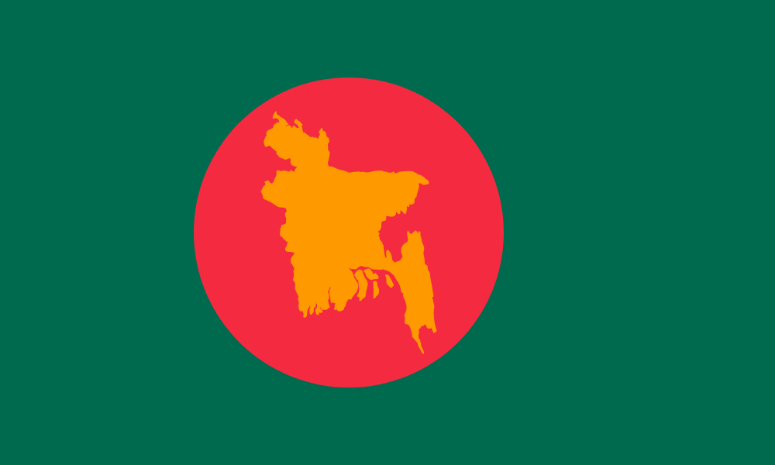
Discover and know country at a glance
Bangladesh
Domain | .bd
Calling Code | +880
Capital | Dhaka
Region
Sub Region
Population
Area
Currency | Name: Taka Symbol: $
Language

